Slide 1

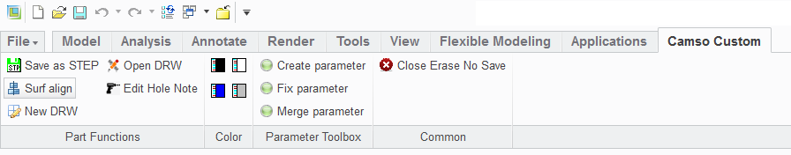


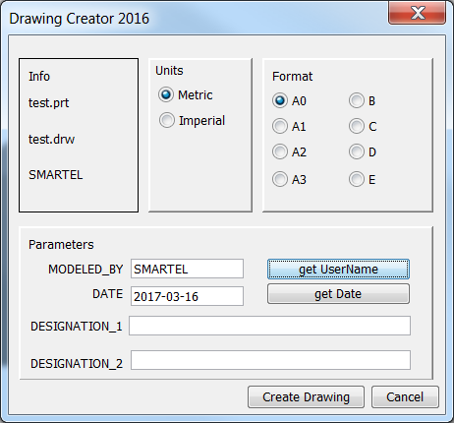
Camso Creo Custom menus toolbars
3D menu
Create parameter
Generate default Camso parameters.
Save as Step
Export active model in step and save it to C:\ptc\_step.
Open DRW
Using the 3D number will try to open a drawing in Windchill or in the working directory.
Fix Parameter.
Reads all parameters save their values, erase all parameters and recreate them with value.
CAUTION:
Surf align
Align selected surface parallel to the screen.
Tool Tips
Instead of using the …
NOTE: Surf align only works with parts or assemblies created using Camso templates
Close erase No Save.
Close active windows and erase not display.
Edit Hole Note
Will open a text file where you can copy paste hole notes.
New DRW
Open Camso Drawing creator.
Fix Parameter.
Merge current model parameters with Camso parameters and create missing parameters.
Color menu change the background colors

Slide 2
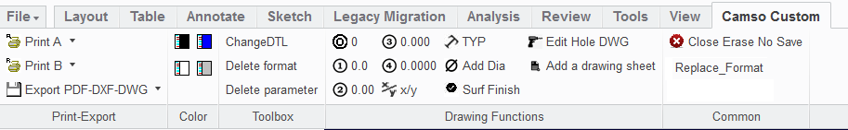
2D menu
Change DTL
Adjust drawing options as per Camso default values.
Delete Parameter.
Delete drawing parameters.
Add a drawing sheet.
Will create a new sheet and run the replace format.
Save as Step
Export active drawing in selected format and save it to C:\ptc\_choosenformat
CAUTION:
Tool Tips
Instead of using the …
Edit Hole Note
Will open a text file where you can copy paste hole notes.
Change the decimal format for selected dimension.
Replace Format
Function use to change the Drawing cartridge.
See: 0027-FormatReplace
NOTE: Surf align only works with parts or assemblies created using Camso templates
Add these symbol to selected dimension.

